Slide 1
Introduction to ChIP-seq data analysis
Ji-Ping Wang
Department of Statistics

Slide 2
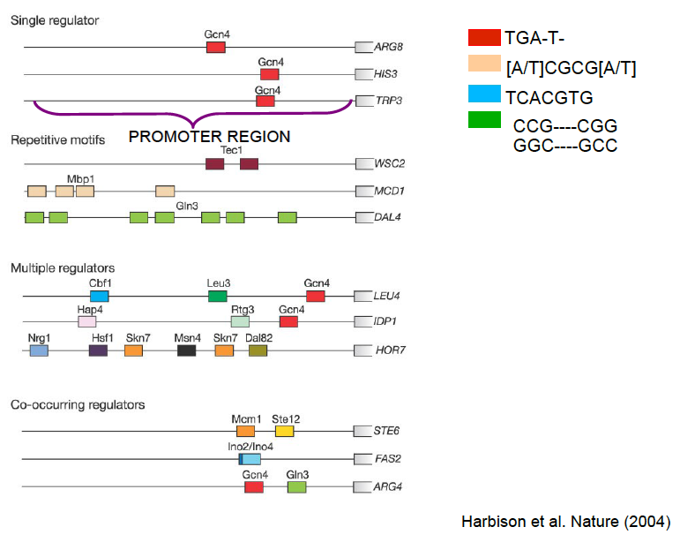
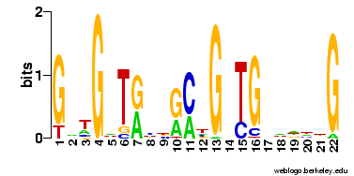
Transcriptional regulation
Transcriptional factors: proteins bound to DNA to facilitate transcription
PHO4

Slide 3
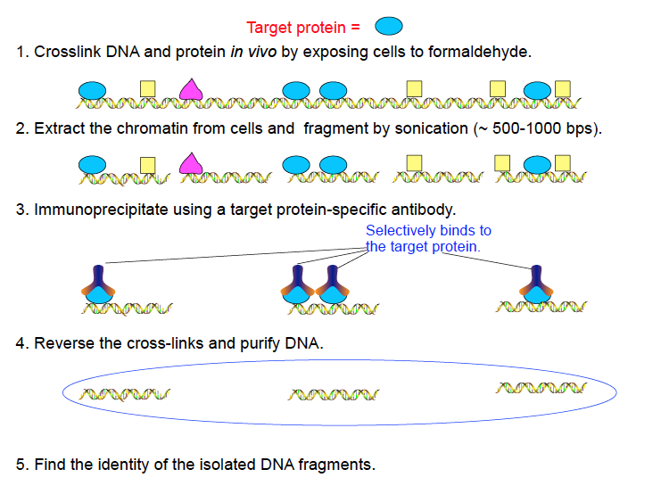
ChIP: Chromatin immunoprecipitation (in vivo)
Keles Lecture notes

Slide 4
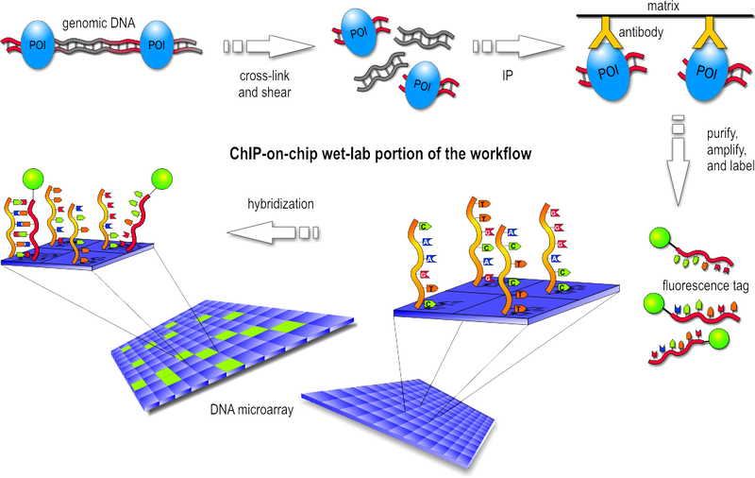
ChIP-on-chip

Slide 5
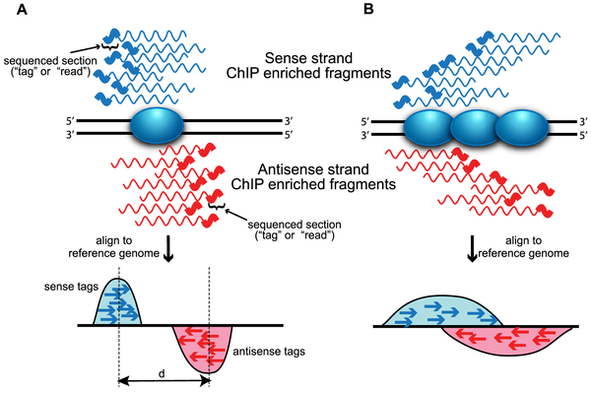
ChIP-seq
Wilbanks et al

Slide 6
Changllenges in ChIP-seq data
Alignment: sequencing errors especially towards the end of each read
Bias: GC-rich content bias library preparation and in amplification
Technical issues: need correct amount of samples, two little samples result in two few tags, too many samples result in fluorescent labels too close to one another leading to lower data quality
Affinity of the antibody
Limited accuracy: only show the enriched regions not the exact binding sites.

Slide 7
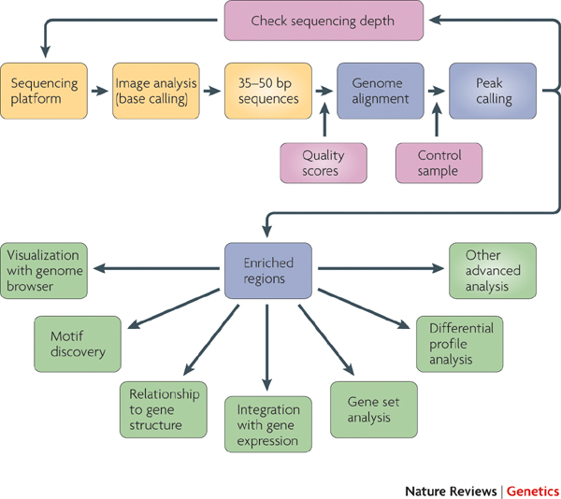
Park 2007

Slide 8
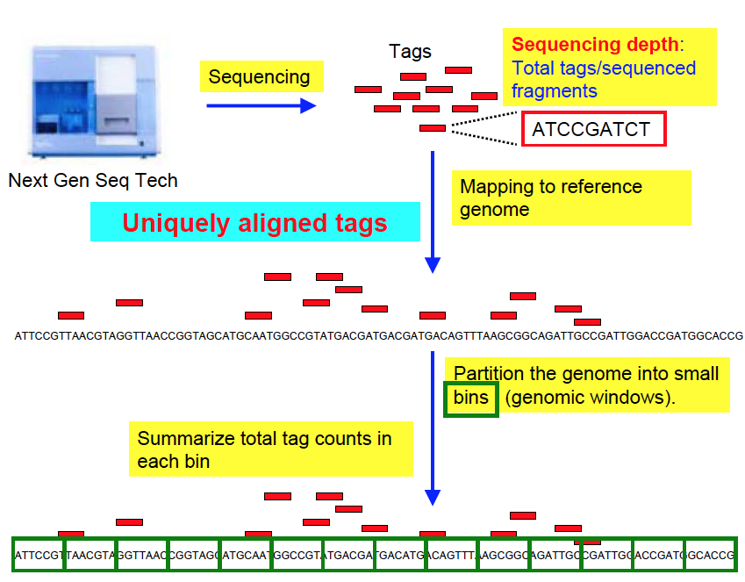
Reads data processing
Keles Lecture

Slide 9
Binning reads from two strands
protein
Binning requires project the DNA fragment center.

Slide 10
Determination of fragment length
Let X_i and Y_j be two series
Cross correlation of X and Y is defined as:

Slide 11
protein

Slide 13
Data structure
Raw reads/quality data 15-20 G per sample
After binning: the genome-wide data is represented by the frequency of reads count within each bin, data size 200 M

Slide 14
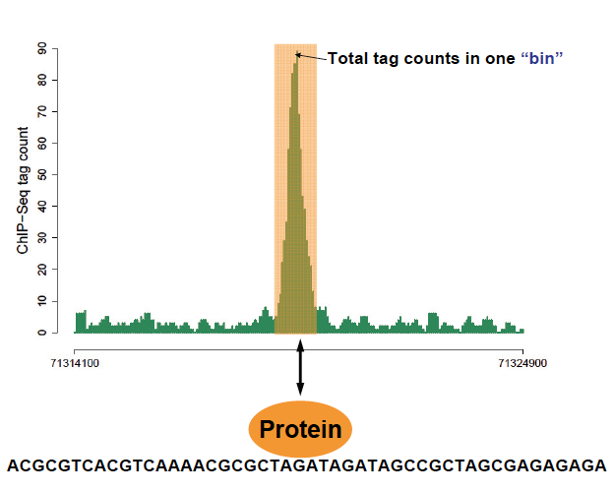
Keles Lecture notes

Slide 15
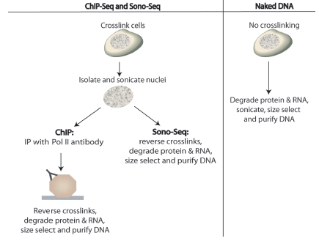
ChIP vs control(input)
Auerbach et al 2009

Slide 16
ChIP vs control (RNAP II ChIP data from Horvath’s lab), IRF3

Slide 17
Mappability

Slide 18
GC content

Slide 19
Statistical issues
How to correct for GC and mappability bias
What a peak can be called a real peak?
How to called peaks with or without control?
How to evaluate the FDR?

Slide 20
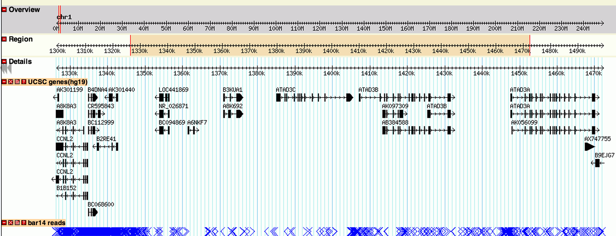

Slide 21
One sample model (no control/input)
Background model: Poisson vs Negative binomial
Poisson:
Negative Binomial:

Slide 23
Model from Kuan et al 2012

Slide 25
R> peaks[1:5,]
chrID peakStart peakStop peakSize aveP minP aveChipCount maxChipCount
1 chr1 61466 61757 292 0.0027008221 2.420411e-04 12 12
2 chr1 62196 62487 292 0.0276126430 5.012264e-04 14 14
3 chr1 534506 534797 292 0.0154107616 4.039905e-04 11 11
4 chr1 567648 567793 146 0.0762860834 7.628608e-02 134 134
5 chr1 600790 601081 292 0.0003932163 4.093351e-05 14 14

Slide 28
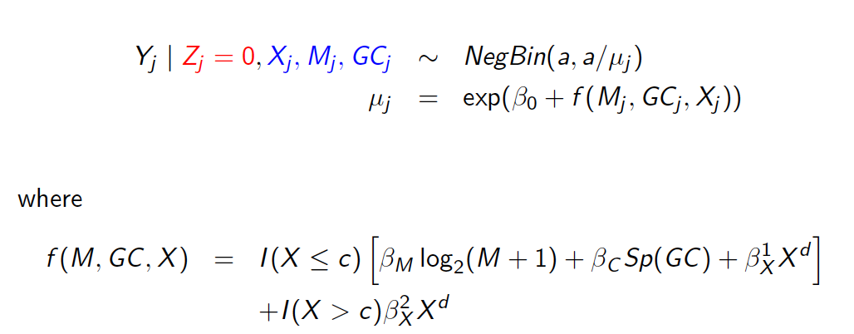
New background model: x_j is the input tag count in bin j

Slide 30
One-sample model
R> peaks[1:5,]
chrID peakStart peakStop peakSize aveP minP aveChipCount maxChipCount
1 chr1 61466 61757 292 0.0027008221 2.420411e-04 12 12
2 chr1 62196 62487 292 0.0276126430 5.012264e-04 14 14
3 chr1 534506 534797 292 0.0154107616 4.039905e-04 11 11
4 chr1 567648 567793 146 0.0762860834 7.628608e-02 134 134
5 chr1 600790 601081 292 0.0003932163 4.093351e-05 14 14
Two-sample model
chrID peakStart peakStop peakSize aveP minP aveChipCount maxChipCount
1 chr1 948562 948853 292 8.661417e-05 1.210972e-11 414 420
2 chr1 1455036 1455181 146 6.199719e-02 6.199719e-02 12 12
3 chr1 1581034 1581179 146 1.283683e-01 1.283683e-01 21 21
4 chr1 1708054 1708199 146 1.068003e-02 1.068003e-02 28 28
5 chr1 1711850 1712141 292 4.939927e-02 2.028397e-02 134 142

Slide 31
From two sample model

Slide 32
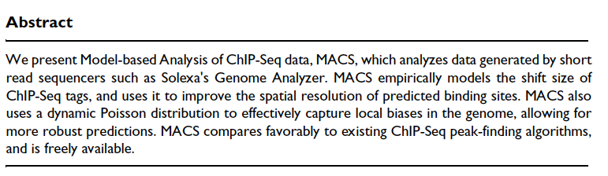
MACS: Model-based analysis of ChiP-seq, Zhang et al

Slide 33
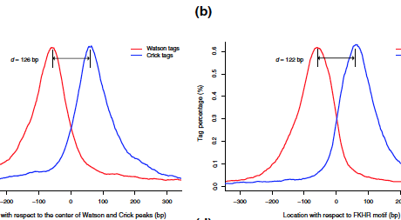
Shift size/Insert site
Base don 1000 randomly selected well-defined peaks genome-wide.

Slide 34
Data processing
Shift 5’ and 3’ end tags towards center by d/2
Removing duplicate tags (tags mapped to the same genomic location)
Normalization tag frequency by total number tags (if control/input data exists)

Slide 35
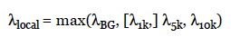
Peak detection
Using sliding window of width 2d
Model tag count as a Poisson statistics.
Background signal is dynamically defined based on the control sample.
Candidate peaks are called by p-value<10^-5

Slide 36
FDR evaluation by sample swapping
MACS define peaks based on ChIP over input, and then defined peaks based on input using ChIP as control. The fraction of the peaks from the second over the first is used to estimate the FDR.

